Slide 1
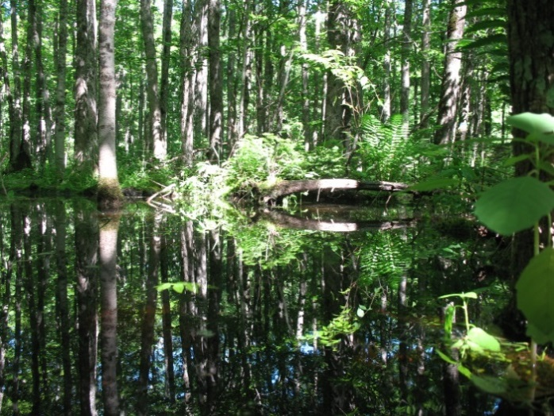







Ecohydrological Evaluation and Management Implications for Black Ash Wetland Ecosystems Threatened by Emerald Ash Borer
Matthew J. Van Grinsven , J. P. Shannon, N. W. Bolton, J.C. Davis, K. Hofmeister, N.J. Noh, E. Stimmel, J. W. Wagenbrenner, R. K. Kolka, and T. G. Pypker
SWS Annual Meeting – May. 30th 2019

Slide 2
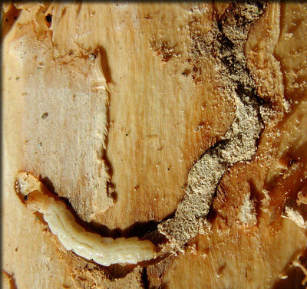
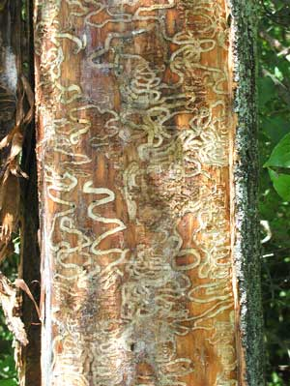
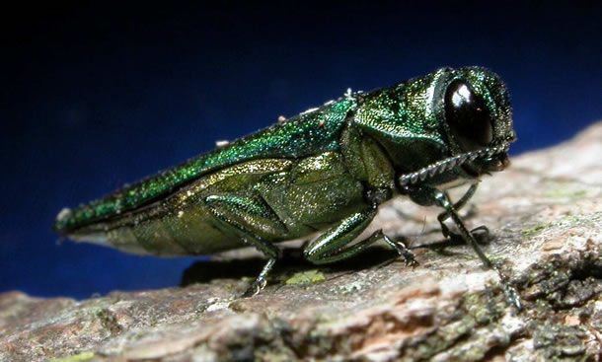
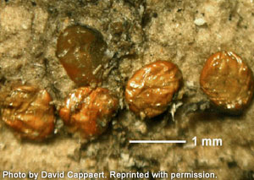
Emerald Ash Borer Infestation Implications
Emerald Ash Borer (EAB) Agrilus planipennis Fairmaire (Coleoptera: Burpestidae)
Exotic and invasive beetle
Larvae bore into and feed on phloem
Disrupting water and nutrient transport within ash trees (Fraxinus sp.)
http://www.emeraldashborer.info/
http://www.esf.edu/extension/ash.htm
http://www.esf.edu/extension/ash.htm
http://labs.russell.wisc.edu/eab/signs-and-symptoms/t
Notes:
Boring tunnels (galleries) effectively girdle the tree, and often dies within a few years following infestation.
35 US States and ## provinces
Agrilus planipennis, commonly known as the emerald ash borer, is a green buprestid or jewel beetle native to northeastern Asia that feeds on ash species.

Slide 3
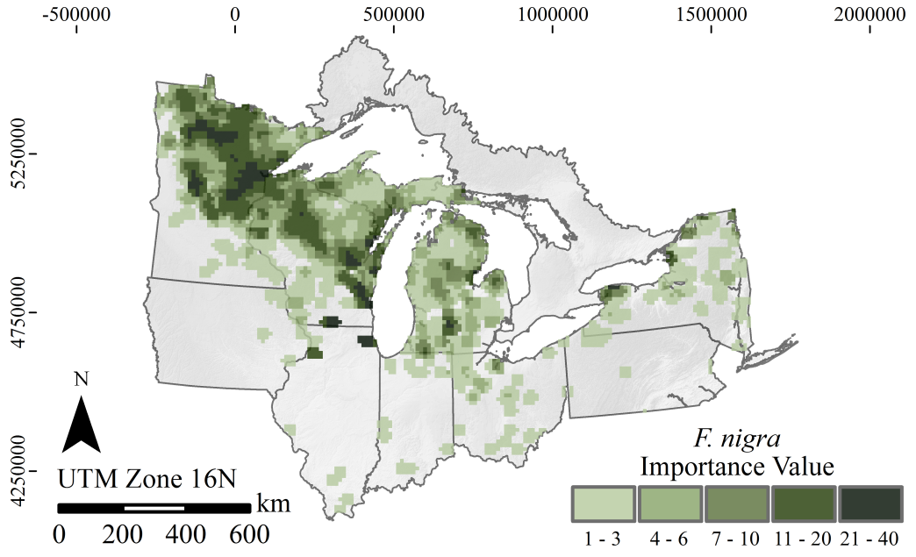
EAB Detection: 2002 - 2019
Current EAB: 35 U.S. States & 5 Canadian Provinces
Killed hundreds of millions of ash trees
http://www.emeraldashborer.info
Notes:
35 US states and 5 CA provinces
Littles range and
Importance value
https://www.aphis.usda.gov/aphis/ourfocus/planthealth/plant-pest-and-disease-programs/pests-and-diseases/emerald-ash-borer

Slide 4
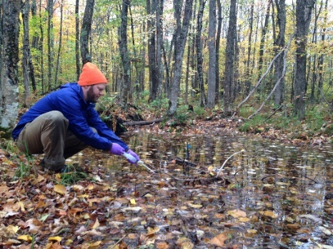
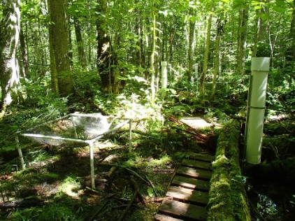
Study Area Overview
Ottawa National Forest
Michigan’s Upper Peninsula contains 56,000 ha of wetlands
18,000 ha of deciduous forested wetlands
70% of wetlands dominated by black ash (Fraxinus nigra)
Notes:
Broad leaf deciduous forestland

Slide 5
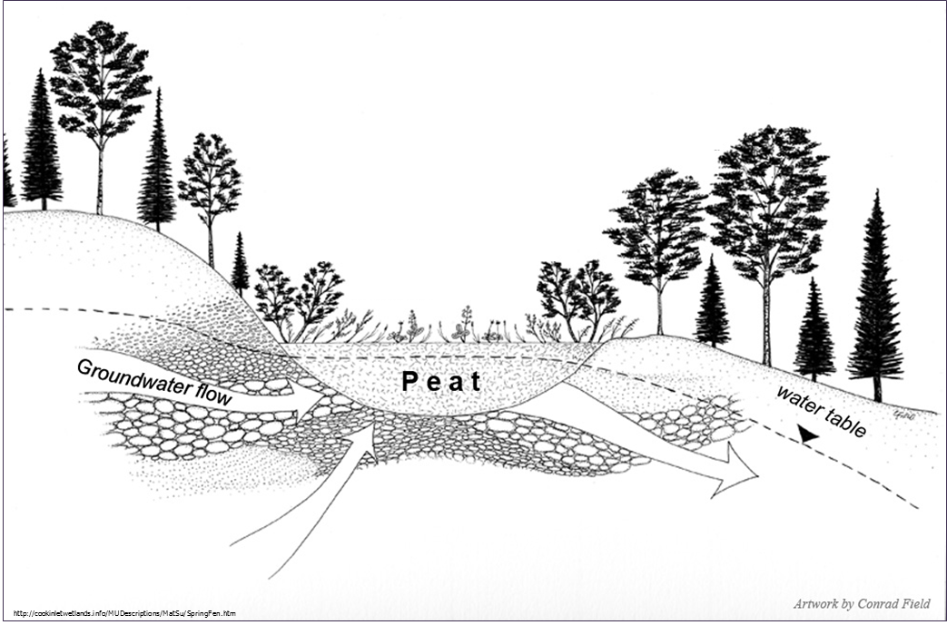
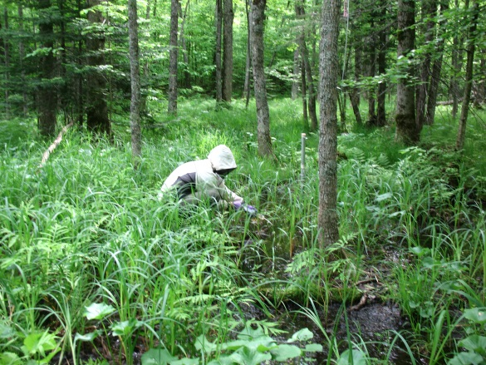
Depressional Black Ash Wetlands
Headwater wetlands
Histosol & histic mineral soils
0.25 – 1.25 ha
66% black ash basal area
Yellow birch and red maple
Carex species highest occurrence and greatest percent cover
http://cookinletwetlands.info/MUDescriptions/MatSu/SpringFen.htm Artwork by Conrad Field
Notes:
Deciduous forested wetland dominated by black ash with red maple and yellow birch as co-dominant canopy species.
Canopy also consists of yellow birch (Betula alleghaniensis) red maple (Acer rubrum)
Fern
species, including Osmunda cinnamomea L. (cinnamon fern), Onoclea
sensibilis, L. (sensitive fern), Athyrium filix-femina (L.) Roth (common
ladyfern), D. carthusiana, and D. intermedia were common and
tended to comprise a large proportion of the herbaceous cover.
Add hydrogeomorphic setting and MN/WI wetland type

Slide 6
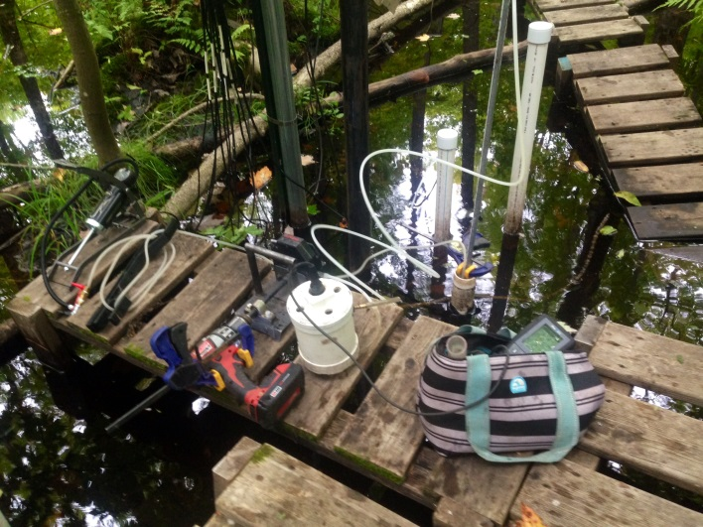
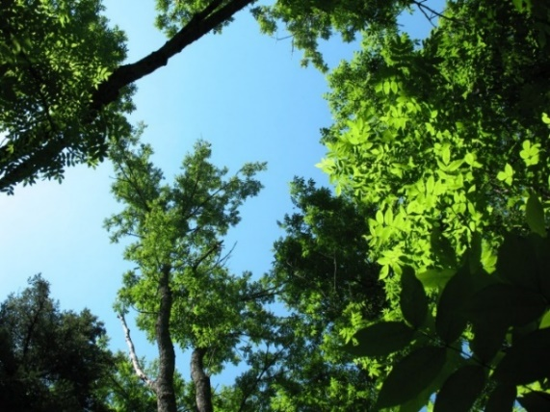
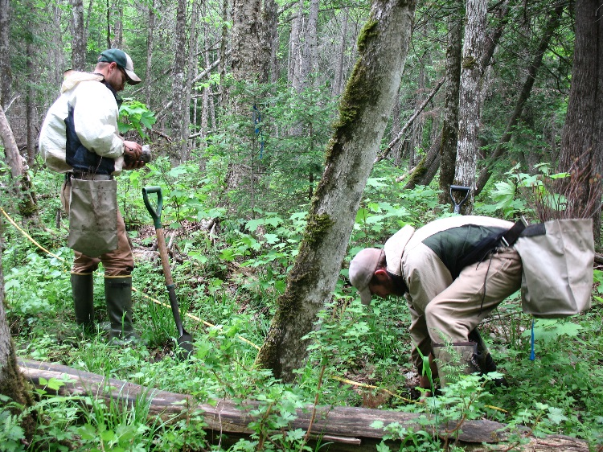
Research Objectives & Management Implications
Research Objectives
Groundwater connectivity, source water contributions & site transpiration
Responses to simulated EAB infestation
Water table fluctuations
Quantify water, carbon and nitrogen loads
Residual vegetation growth and regeneration
Planted alternative species growth & survival

Slide 7
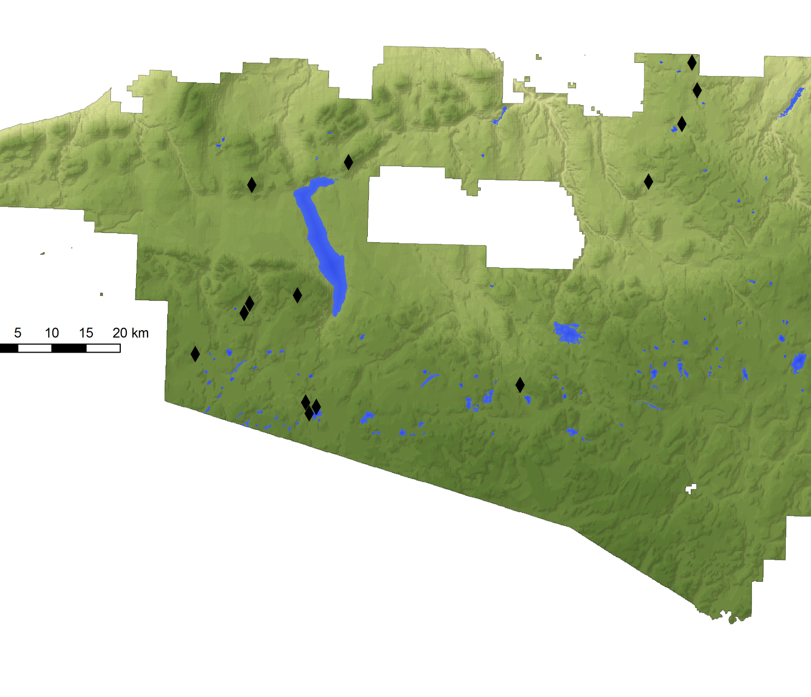
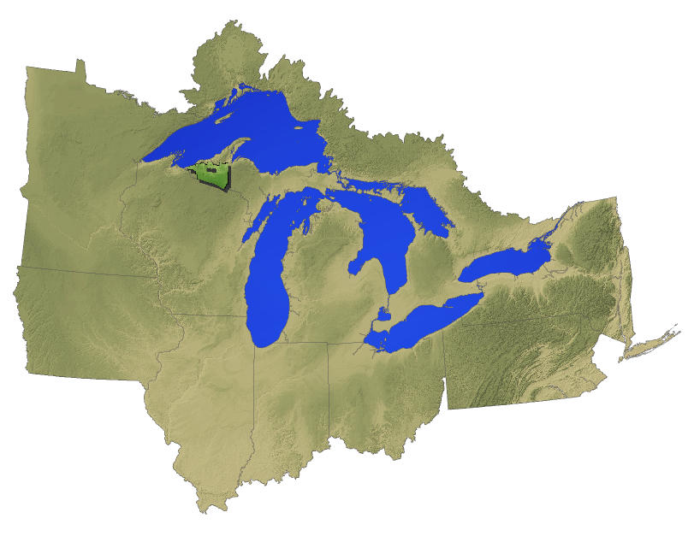
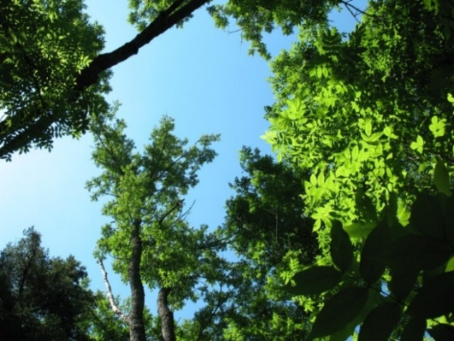
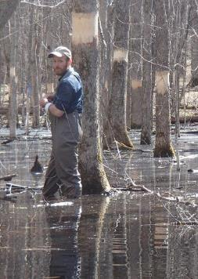
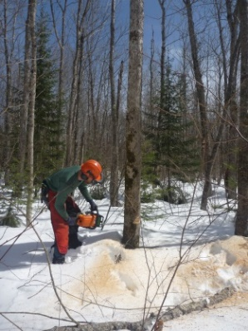
Study Area and Experimental Design
14 wetlands with 3 treatments
Control
Girdle (girdle ash stems ≥ 1” DBH)
Ash-Cut (hand-fell ash stems ≥ 1” DBH)
Timeline
Baseline conditions, 2011-2012
Treatments applied, Winter 2012-13
Control
Girdle
Ash-Cut
Notes:
Update with Main 9 site description
Sites are 35 km apart
10 m elevation difference (C 500m A 490m)
Monitored physical and chemical properties of wetland and outflowing water.
Surrounded by northern hardwood forestland

Slide 8
Study Area and Experimental Design
9 wetlands with 3 treatments
Source water contributions
Water level monitoring
Sap flux estimation for canopy species
Residual vegetation growth and regeneration
Control
Girdle
Ash-Cut

Slide 9
Study Area and Experimental Design
3 wetlands with 3 treatments
Planted 1800 alternative species seedling growth and survival
Paired hummock & hollow planting design
Control
Girdle
Ash-Cut
Notes:
Update with Main 9 site description
Sites are 35 km apart
10 m elevation difference (C 500m A 490m)
Monitored physical and chemical properties of wetland and outflowing water.
Surrounded by northern hardwood forestland

Slide 10
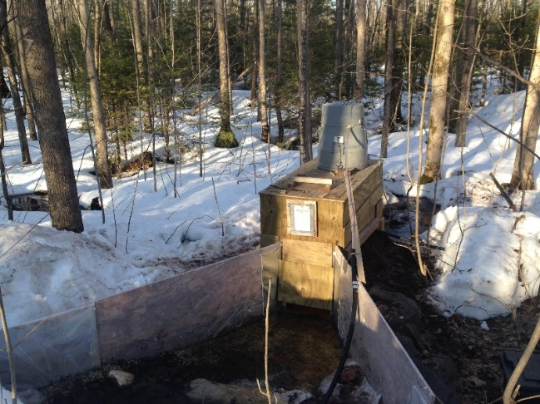
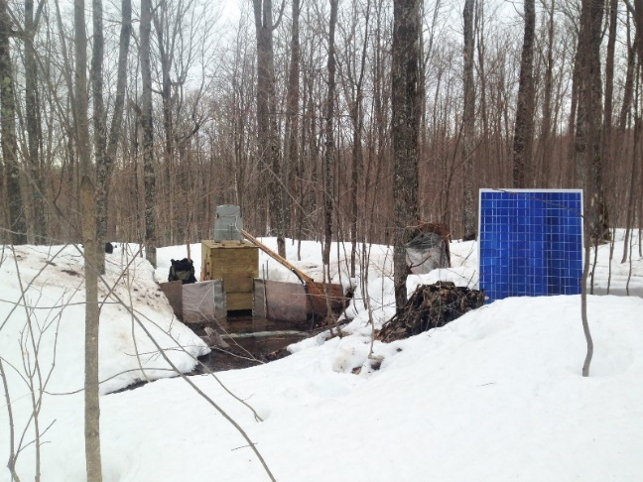
Study Area and Experimental Design
Paired watershed study with control and ash-cut treatments
Water yield
DOC & TDN exports
Soil decomposition & chemistry
Control
Ash-Cut
Notes:
Update with Main 9 site description
Sites are 35 km apart
10 m elevation difference (C 500m A 490m)
Monitored physical and chemical properties of wetland and outflowing water.
Surrounded by northern hardwood forestland

Slide 11
Results: Physical Soil Properties
1
Chimner et al. 2012
Notes:
Horizontal dominated flow not vertical

Slide 12
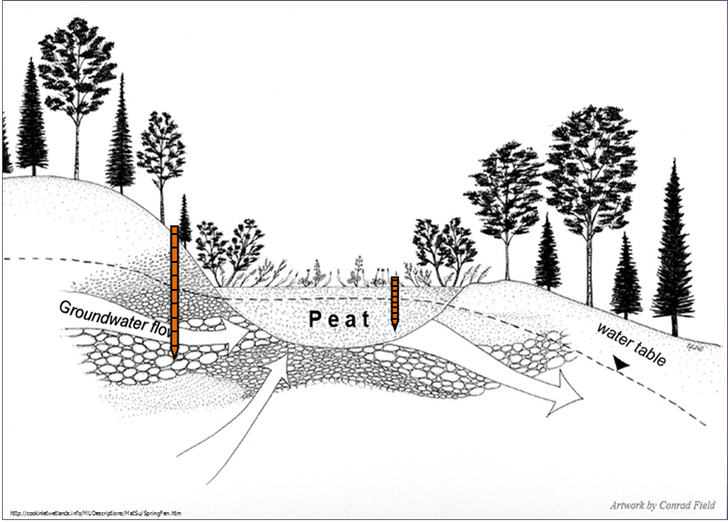
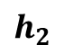
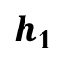
Results: Hydraulic Gradient
Persistent gaining conditions detected
Gaining
$h_{2}$
$$h_{1}$$
Losing
Van Grinsven et al. 2017
Notes:
June – July
Throughout post-treatment

Slide 13
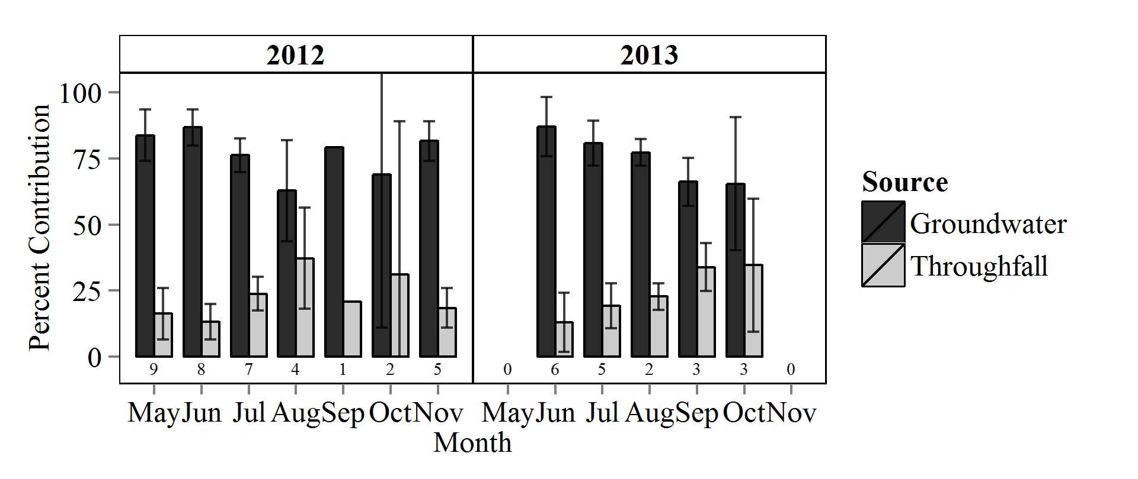
Results: Water Isotope Signatures
Wetland soil water 𝛿 ²H signatures were similar to groundwater
Black ash wetlands predominantly supplied by groundwater
75% Mean Contribution
Van Grinsven et al. 2017
Notes:
Corroborating evidence
Compare the two major source
Sample lsmean SE
Groundwater -85.62183 2.521993
Throughfall -52.41983
Wetland Soil -79.36150

Slide 14
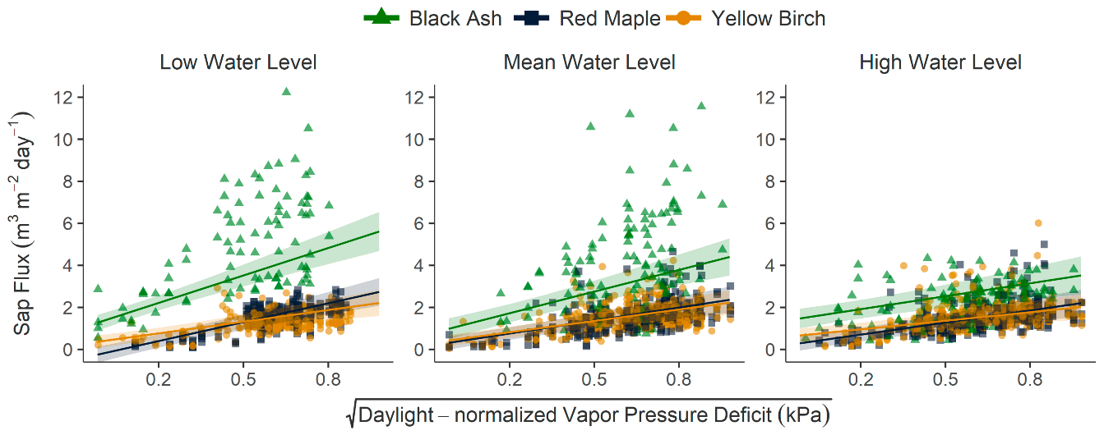
Results: Sap Flux Estimation
Black ash sap flux was 80–160% higher than non-black ash at all water levels
Black ash sap flux was 45% higher at lowest water levels
Shannon et al. 2018
Notes:
Exploration of alternative canopy species has focused on the survival and growth of seedlings, but our findings show important differences in water use and response to hydrologic drivers among species.
For the analysis of species-level differences at high, mean, and low water levels, water levels were binned with breakpoints defined as μ±0.5σ. Breakpoints were calculated separately for each species to account for differences in relative elevation.

Slide 15
Results: Site Transpiration and Water Tables
70% reduction in site transpiration attributed to removal of black ash
Significantly lower water table drawdown rates & higher water levels detected in treated sites during post-treatment growing season
Van Grinsven et al. 2017
Notes:
Significantly higher water tables detected in treated sites in Northern MN (CNF) during post-treatment study period
Much larger sites that exists as 100 – 150 ha wetland complexes (spruce/fir) with mineral soils

Slide 16


Results: Water, DOC & TDN Loads
Daily exports normalized using watershed area for comparison
Streamflow: mm d⁻¹
DOC: kg ha⁻¹ d⁻¹
TDN: kg ha⁻¹ d⁻¹
Control
Ash-Cut

Slide 17
Results: Water, DOC & TDN Load Responses
Water Yield
Post-treatment Ash-Cut mean: 0.12 mm d⁻¹
44% greater than Control
DOC Load
Post-treatment Ash-Cut mean: 0.02 kg ha⁻¹ d⁻¹
114% greater than Control
TDN Load
Post-treatment Ash-Cut mean: 6.4 x 10⁻⁴ kg ha⁻¹ d⁻¹
105% greater than Control
Notes:
Post-treatment response slope & mean load significantly larger in Ash-Cut
Response of daily Ash-Cut water yield to daily Control water yield
1% observations removed due to influential leverage
24 of 1834 observations removed for A~C plot
81% total water yield preserved (19% water yield removed)
Large events occurred in one site, but not the other (summertime convective storms).
lme.wy <- lmer(dnd.ln~Treatment*pp+(1|yearA/Season), data=flowday)
Post_T wyield
C: 0.08
Both sites were lower (C @ p<0.1) during post-treatment
Pre_T wyield – A was 19% lower
C: 0.33
A: 0.28

Slide 18
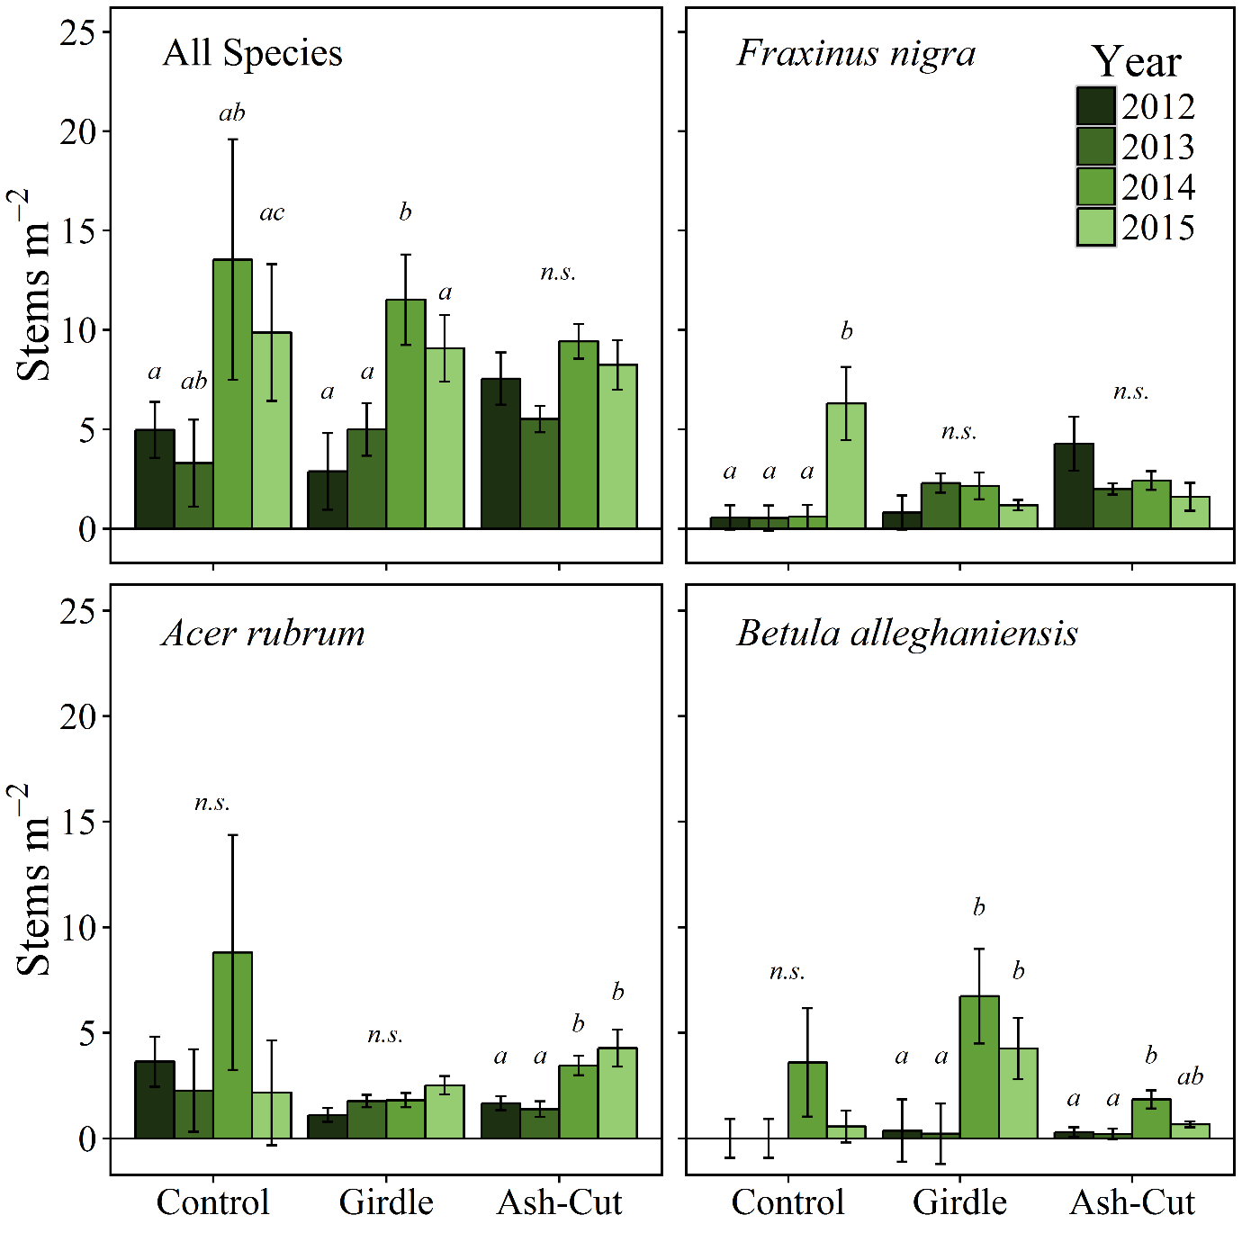
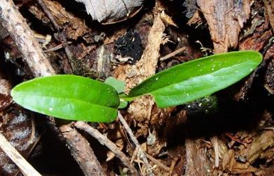
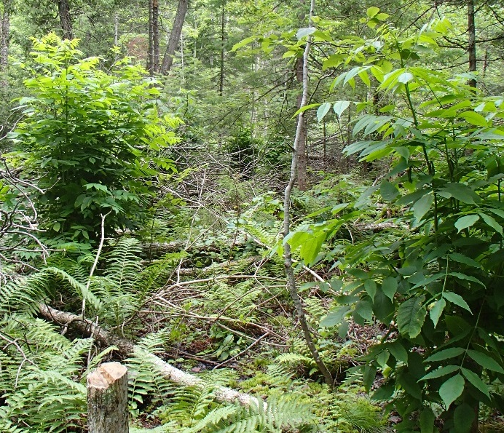
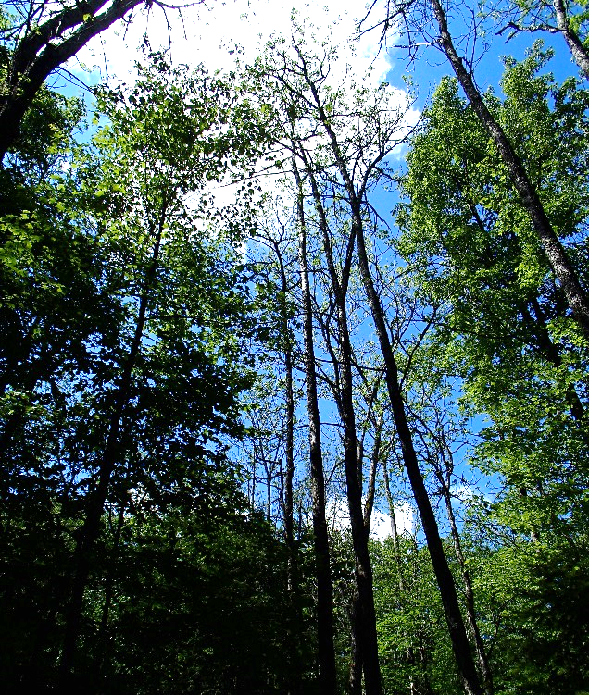
Results: Residual Species Regeneration
Increased red maple & reduced black ash seedlings in treated sites
Water levels not preventing natural regen.
No overall change in canopy growth rate or canopy and sapling basal areas
Non-ash overstory mortality was significant in some sites
Davis et al. 2016
Notes:
Epicormic branching of black ash stems not quantified, but abundant across both treatment types
Mortality was significant in some but not all sites

Slide 19
Results: Planted Alternative Species
American elm, basswood, silver maple, and northern white cedar are suitable options for species transition and retaining forested wetlands
Plantings should be focused on natural hummocks within the wetlands
Bolton et al. 2018
Notes:
American elm Ulmus Americana L. 2 P
basswood (linden) Tilia americana L. 3 BR
burr oak Quercus macrocarpa Michx. 3 BR
red maple Acer rubrum L. 2 BR
silver maple Acer saccharinum L. 4 BR
yellow birch Betula alleghaniensis Britton 2 P
balsam fir Abies balsamea (L.) Mill 2 BR
black spruce Picea marina (Mill.) Britton 2 P
northern white cedar Thuja occidentalis L. 2 P
tamarack Larix larcinia K. Koch 2 BR

Slide 20
Conclusions: Response to simulated EAB Infestation
Persistently gaining groundwater conditions
75% groundwater contributions
Significantly smaller rates of drawdown in treated sites
Due to significant decrease in transpiration
Mean water table positions were significantly higher in treated sites during the end of the growing season
Significantly higher post-treatment mean: water yield (+ 44%), DOC load (+ 114%) and TDN load (+ 105%)
Notes:
prepost
lme.T<-lmer(t24~treatment*pp +(1|site/yearA),data=trans)
monthly
lme.T<-lmer(t24~treatment*pp*monthA +(1|site/yearA),data=trans)

Slide 21
Management Implications
Post-treatment water levels are not inhibiting recruitment and regeneration of red maple
No change in canopy growth rate or canopy and sapling basal areas
Based upon 3 years of post-treatment monitoring
American elm, basswood, silver maple, and northern white cedar are suitable mitigation and management options
Plantings should be focused on natural hummocks within the wetlands
Notes:
prepost
lme.T<-lmer(t24~treatment*pp +(1|site/yearA),data=trans)
monthly
lme.T<-lmer(t24~treatment*pp*monthA +(1|site/yearA),data=trans)

Slide 22
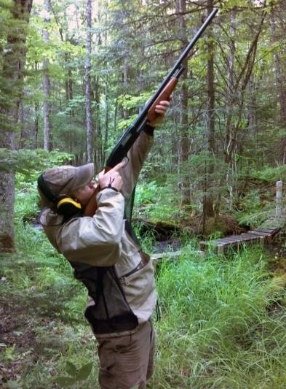
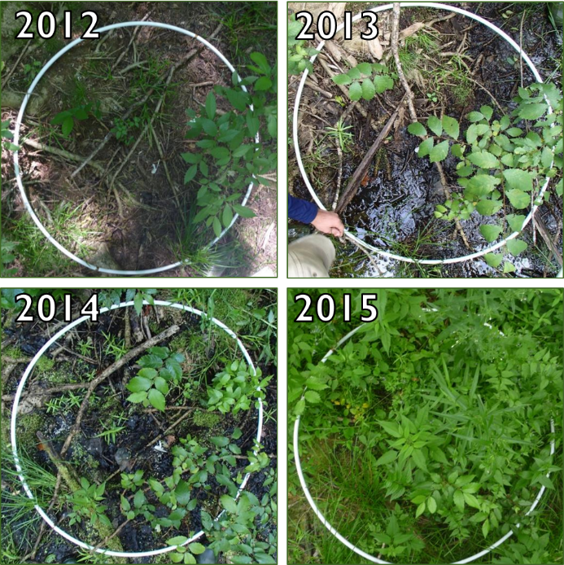
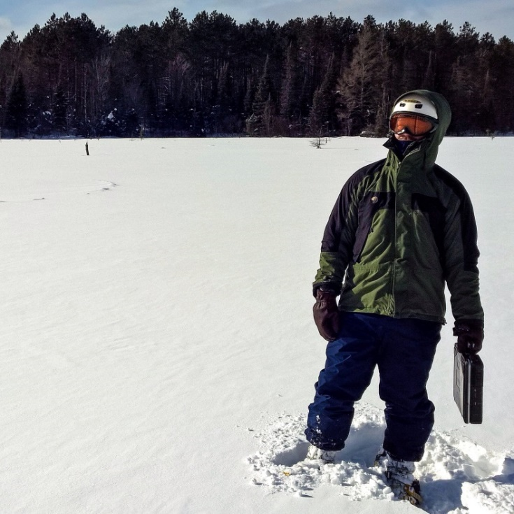
Thank You
Davis et al. 2016
Notes:
Sedge species showed the greatest increase in percent cover
Obligate wetland and disturbance-adapted species commonly responded

Slide 24
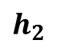
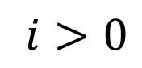
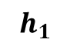
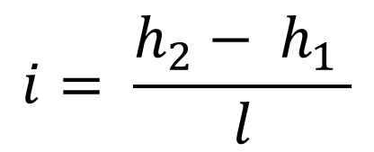

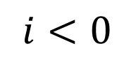
Hydrogeological Assessment
Hydraulic Gradient
Groundwater connection
Gaining:
Losing:
$$i= \frac{h_{2}− h_{1} }{l}$$
$l$
Gaining
$h_{2}$
$$h_{1}$$
$i>0$
Losing
$i<0$

Slide 25
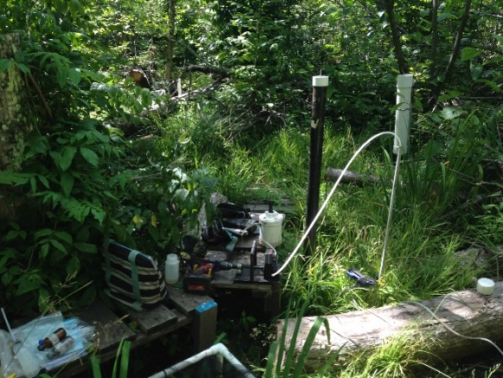
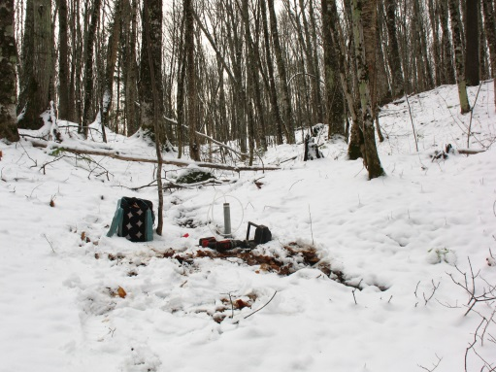
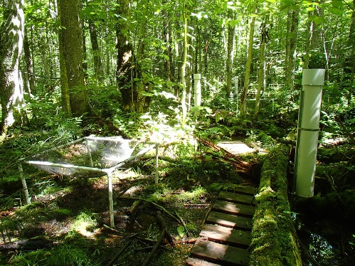
Source Water Estimation Methods
EPA’s IsoError Linear Mixing Model
Mixture
Sources
Wetland Soil Water
Groundwater
Throughfall

Slide 26
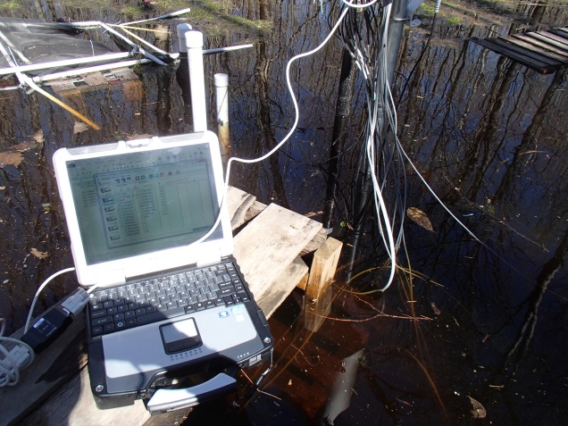

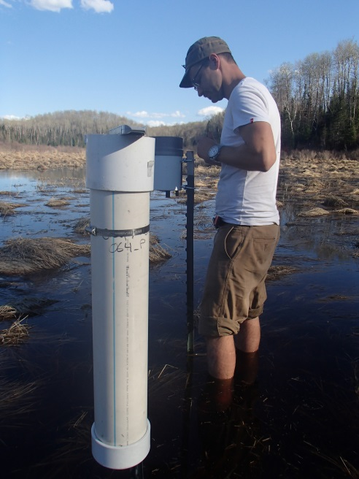
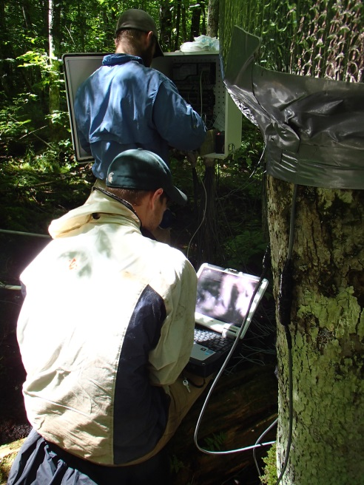
Hydrological Response Methods
Water levels
Manual & logged measurements
Precipitation
Co-located tipping buckets
Transpiration
Granier-style sap-flux probes

Slide 27


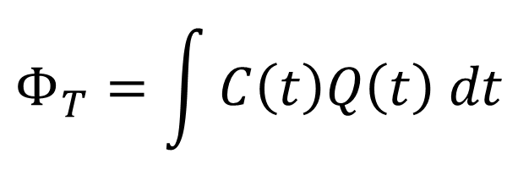
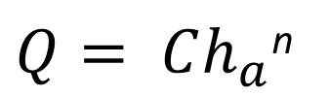
Paired Watershed Methods
Ephemeral outflow streams equipped with:
Stream gage
6” Parshall flume
Pressure transducer
Auto-samplers
Teledyne ISCO
Discrete interval
Discharge
(Bos 1989)
Load estimation
Period weighted with linear interpolation
Chemistry
DOC & TDN
$Q= Ch_{a}$^{n}
$$Φ_{T}=\int{C\left(t\right)Q\left(t\right) dt}$$
Notes:
Bos: where discharge is the product of the Parshall Flume throat coefficient time the height of water (stage) and n is a flume geometry correction factor
Mass flux (Φ) is the product of constituent concentration (C) and discharge (Q) integrated over time (t):
Where mass flux equals the product of the constituent concentration and discharge integrated over time
“Stream-water constituent mass flux, often referred to as load, is the mass of a chemical constituent or sediment transported past a stream cross-section over a defined period of time. Mass flux (Φ) is the product of constituent concentration (C) and discharge (Q) integrated over time (t):
Flux calculations using the integral in equation 1 require a continuous record of concentration and discharge.
Teledyne ISCO 3700

Slide 28
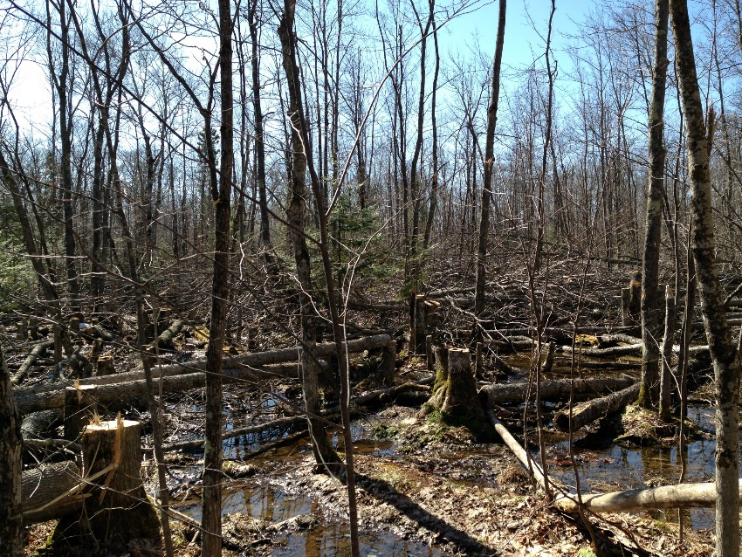
Study Area and Experimental Design
Headwater wetlands with histic-mineral soils dominated by black ash
Ephemeral streams, characterized by large springtime snowmelt
Treatment Application
Hand-fell black ash: 2015
Pre-treatment: 2013-14
Post-treatment: 2015-16
Control Site
Watershed: 26 acre
Wetland: 2.9 acre
Ash-Cut Site
Watershed: 23 acre
Wetland: 2.3 acre
Ash-Cut
Control
Notes:
Update with Main 9 site description
Sites are 35 km apart
10 m elevation difference (C 500m A 490m)
Monitored physical and chemical properties of wetland and outflowing water.
Surrounded by northern hardwood forestland

Slide 29

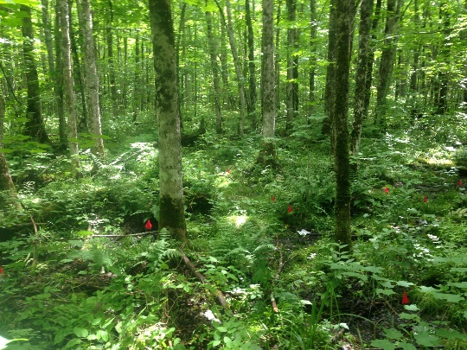
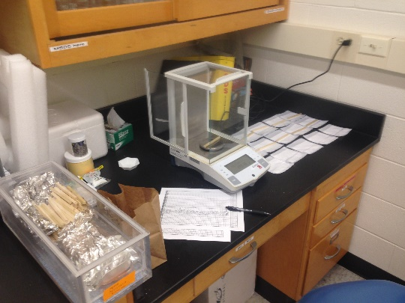
Wetland Instrumentation & Analysis
Three instrument clusters within each wetland used for:
Grab samples:
Surface and soil-pore water
DOC and TDN concentration
Air & soil temperature
iButton temp. loggers
Soil decomposition
Aspen dowels in nylon bags
Mass based determination to assess decomp. rates

